Slide 1
Tuples

Slide 2
Creating
Tuples are just same as the list, which is used to store multiple value.
Tuple is one of 4 built-in data types in Python used to store collections of data.It is a collection of data which is ordered, and unchangeable.
thistuple = ("apple", "banana", "cherry")
print(thistuple)

Slide 3
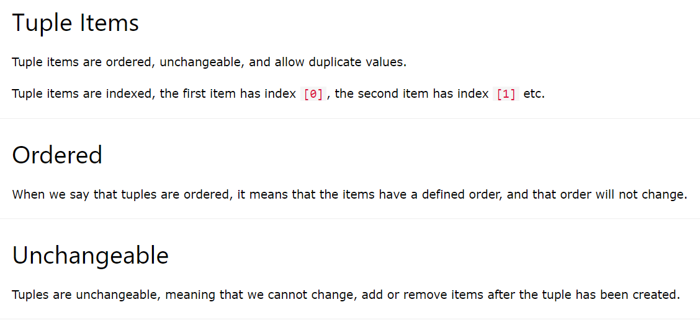
Tuples

Slide 4
Tuple Length
thistuple = ("apple", "banana", "cherry")
print(len(thistuple))
Tuple items can be of any data type:
tuple1 = ("apple", "banana", "cherry")
tuple2 = (1, 5, 7, 9, 3)
tuple3 = (True, False, False)
tuple1 = ("abc", 34, True, 40, "male")

Slide 5
Access Tuple Items
thistuple = ("apple", "banana", "cherry")
print(thistuple[1])
thistuple = ("apple", "banana", "cherry")
print(thistuple[-1])

Slide 6
Range of values
thistuple = ("apple", "banana", "cherry", "orange", "kiwi", "melon", "mango")
print(thistuple[2:5])

Slide 7
When starting value is not specified
thistuple = ("apple", "banana", "cherry", "orange", "kiwi", "melon", "mango")
print(thistuple[:4])
thistuple = ("apple", "banana", "cherry", "orange", "kiwi", "melon", "mango")
print(thistuple[2:])

Slide 8
Negative Range
thistuple = ("apple", "banana", "cherry", "orange", "kiwi", "melon", "mango")
print(thistuple[-4:-1])

Slide 9
Change tuple Values
x = ("apple", "banana", "cherry")
y = list(x)
y[1] = "kiwi"
x = tuple(y)
print(x)

Slide 10
Adding items
thistuple = ("apple", "banana", "cherry")
y = list(thistuple)
y.append("orange")
thistuple = tuple(y)

Slide 11
Remove the item
thistuple = ("apple", "banana", "cherry")
y = list(thistuple)
y.remove("apple")
thistuple = tuple(y)

Slide 12
To del the tuple completely
thistuple = ("apple", "banana", "cherry")
del thistuple
print(thistuple)

Slide 13
Unpacking the tuple
fruits = ("apple", "banana", "cherry")
(green, yellow, red) = fruits
print(green)
print(yellow)
print(red)

Slide 14
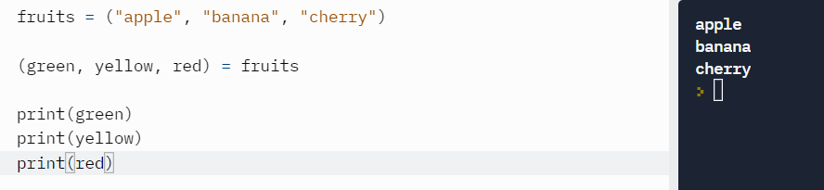
Unpacking

Slide 15
Count and index
count() | Returns the number of times a specified value occurs in a tuple
index() | Searches the tuple for a specified value and returns the position of where it was found

